Slide 1
Office 365 Development

Slide 2


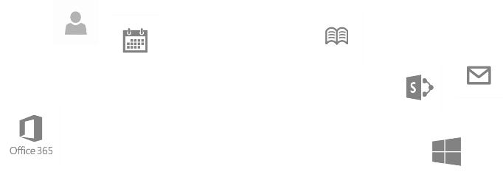
Recap
Deep Dive into Integrating Office 365 APIs with Web Applications
Module 1: Deep Dive into Azure AD with the Office 365 APIs
Module 2: Deep Dive into Office 365 APIs for Calendar, Mail, and Contacts
Module 3: Deep Dive into Office 365 APIs for OneDrive for Business
Module 4: Deep Dive into Office 365 APIs for SharePoint Site services
Module 5: Deep Dive into Office 365 APIs for Yammer services
Module 6: Deep Dive into Office 365 APIs for Office Graph
Module 7: Deep Dive into Office 365 APIs for OneNote services
dev.office.com/training

Slide 3
This Course Agenda
Deep Dive into Integrating Office 365 APIs with mobile device development
Module 1: Universal Windows App Development with Office 365 APIs in Visual Studio 2013
Module 2: Cordova Development with Office 365​ APIs in Visual Studio 2013
Module 3: Xamarin Development with Office 365 APIs in Visual Studio 2013

Slide 4
Universal Windows App Development with Office 365 APIs in Visual Studio 2013
Speaker
Speaker

Slide 5

Agenda
Introduction
Universal App projects
Integrating Office 365 APIs

Slide 6
Introduction

Slide 7
Universal Windows Apps
Announced at //build/ 2014
Three major goals
Reach customers across phones, tablets and PCs
Deliver innovation that supports developer investments
Make cross-platform technology easier and more capable
Delivered in Visual Studio 2013 Update 2

Slide 8
Universal App Project

Slide 9
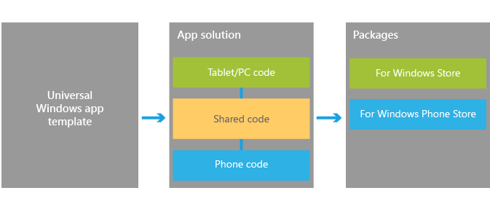
Visual Studio support
Windows App Certification Kit
Project template
Notes:
https://dev.windows.com/en-us/develop/Building-universal-Windows-apps
The Windows App Certification Kit has been extended to Phone apps. This allows a universal app to be in both Stores

Slide 10
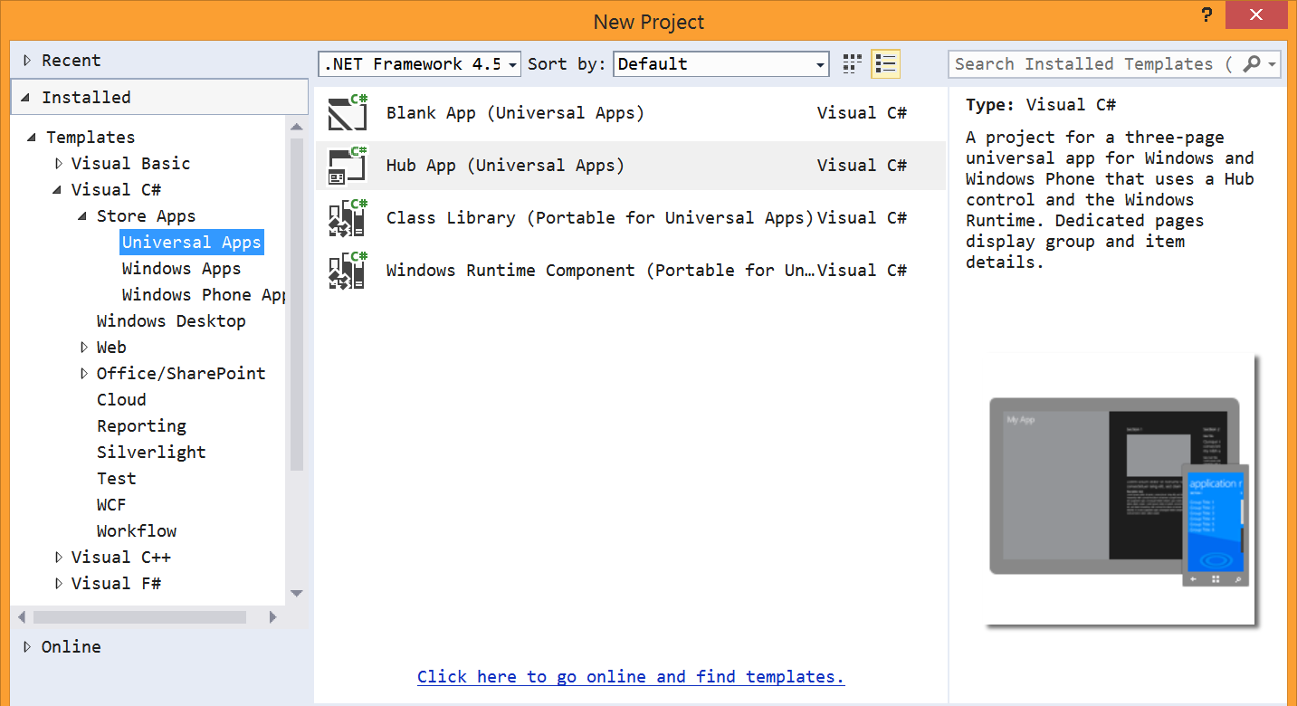
Universal App project template

Slide 11
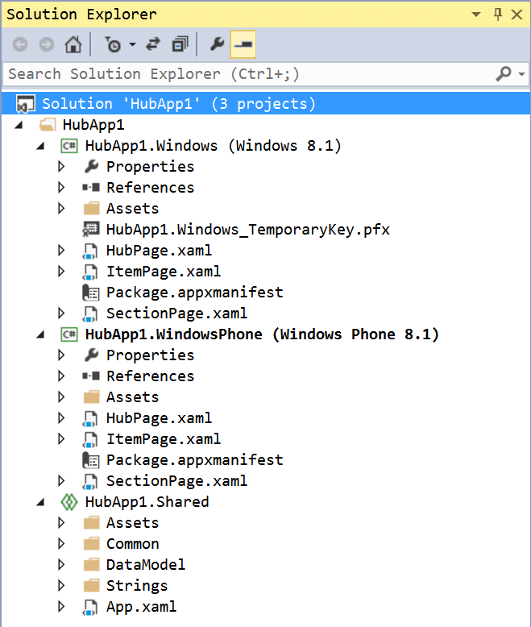
Universal App project template
Solution contains three projects
Windows
Phone
Shared
Shared is a special project type
File type is “shproj”
Does not contain references
Does not build

Slide 12
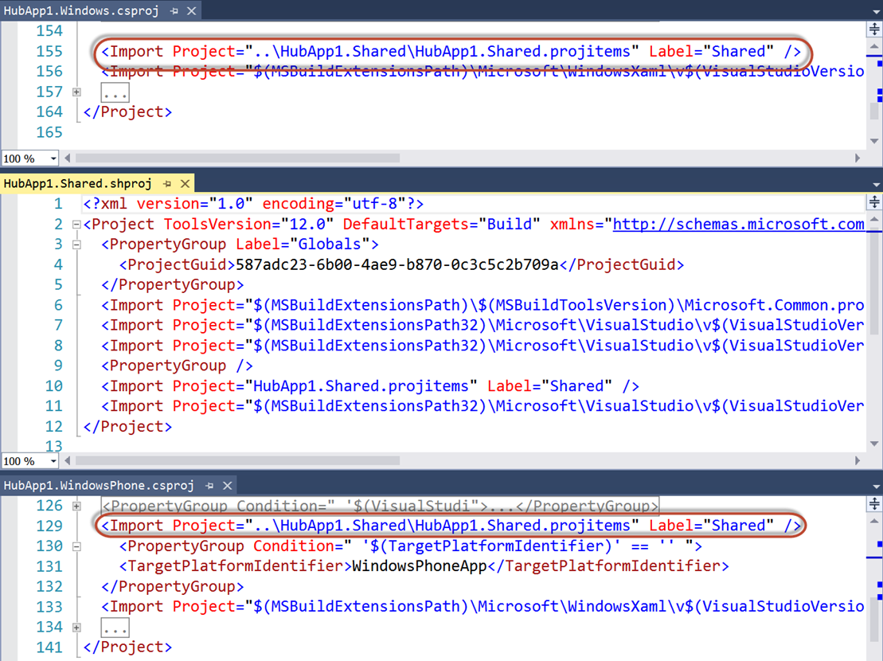
Universal App project template
Shared items imported into other projects
Compile-time constants
#if WINDOWS_APP
#endif
#if WINDOWS_PHONE_APP
#endif

Slide 13
Universal App project template
Contains sample data in Shared project
SampleData.json
Phone app is completely data-bound
Windows app only binds “Section 3”

Slide 14
demo
Universal App template
Notes:
Create a new HubApp project. Show the sample data and datasource
Right-click on windows app, set as startup project. Then open code-behind of HubPage and show the NavigationHelper_LoadState method. Point out the call to the sample data source. Run the project (F5)
Right-click on phone app, set as startup project. Again, show code behind of HubPage, pointing out the similarities. The same method loads the same sample data. Run the project (F5)

Slide 15
Integrating Office 365

Slide 16
Add Office 365 to Universal App
Add Connected Service
Need to add to both Windows and Phone projects
As of September 2014, Office 365 libraries not compatible for Phone projects
Create a data source
XAML makes heavy use of data binding, embrace that paradigm
Stateful client
Initiate login/consent and store Discovery Context

Slide 17
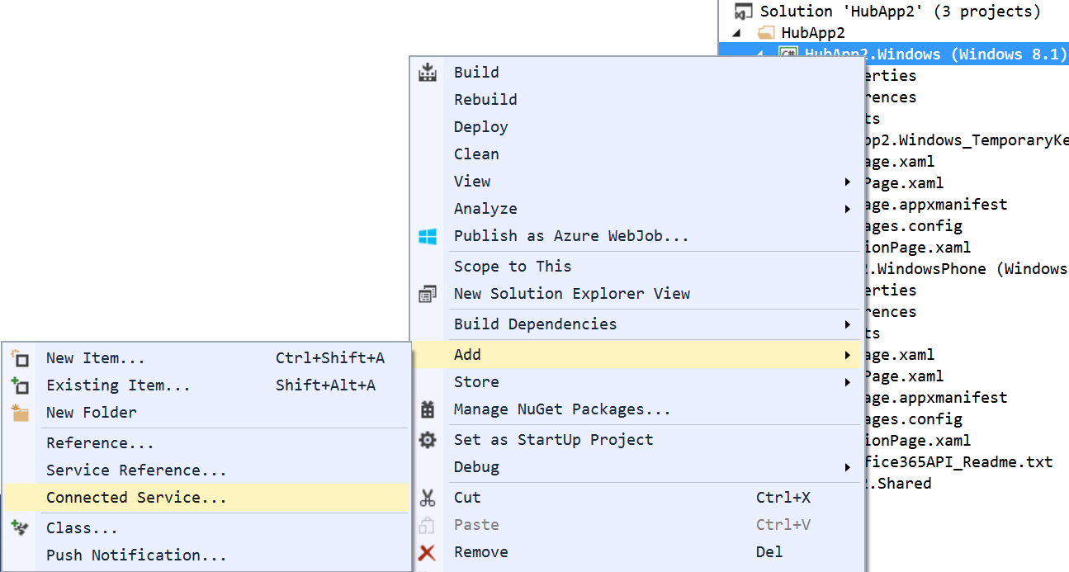
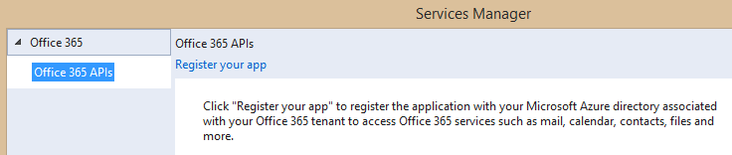
Adding Connected Services
1
Project > Add > Connected Service…
2
Register your app

Slide 18
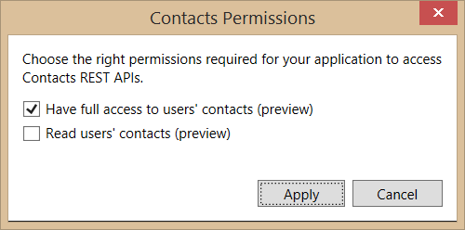
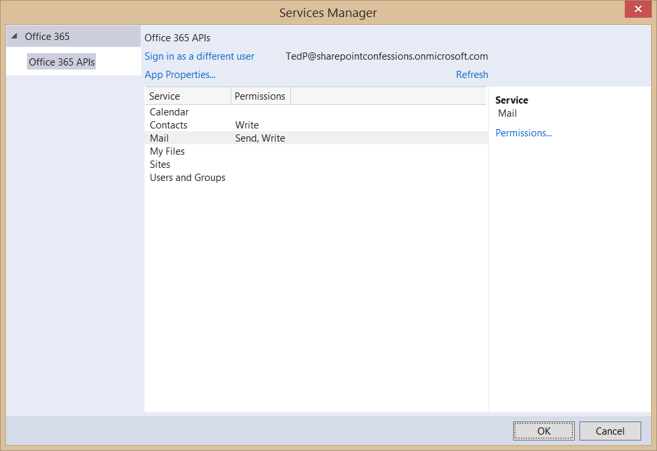
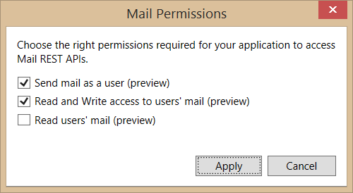
Connected Services Permissions
3
Select required app permissions

Slide 19
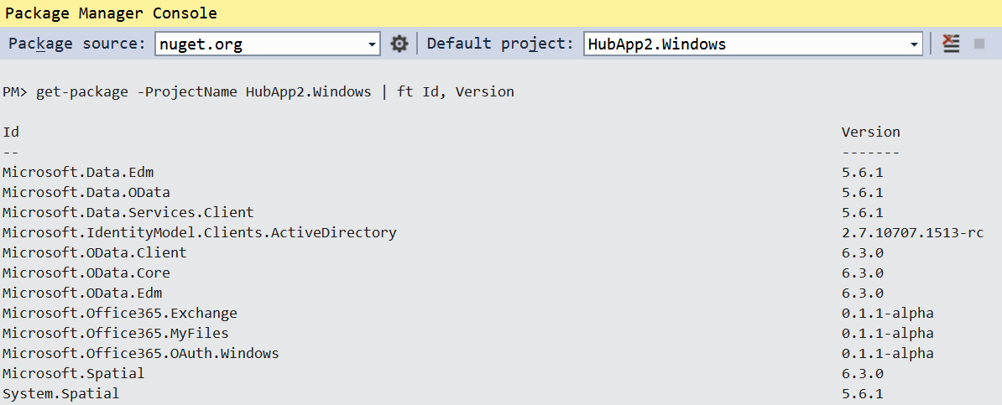
Add Connected Service
Installs NuGet Packages for Office 365 and dependencies

Slide 20
OAuth Implementation
Web-based apps use passive authentication
Accomplished via browser redirects
Universal Apps use active authentication
App code (or library code) initiates call to authentication source
The “Connected Service” wizard adds the appropriate library
Microsoft.Office365.OAuth.Web.dll for web projects
Microsoft.Office365.OAuth.WindowsStore.dll for native projects

Slide 21
Authentication in O365 API Libraries
How it works
Create a DiscoveryContext
DiscoveryContext will invoke WebAuthenticationBroker (WAB)
WAB will display logon form and common consent form
if (_discoveryContext == null)
{
_discoveryContext = await DiscoveryContext.CreateAsync();
}

Slide 22
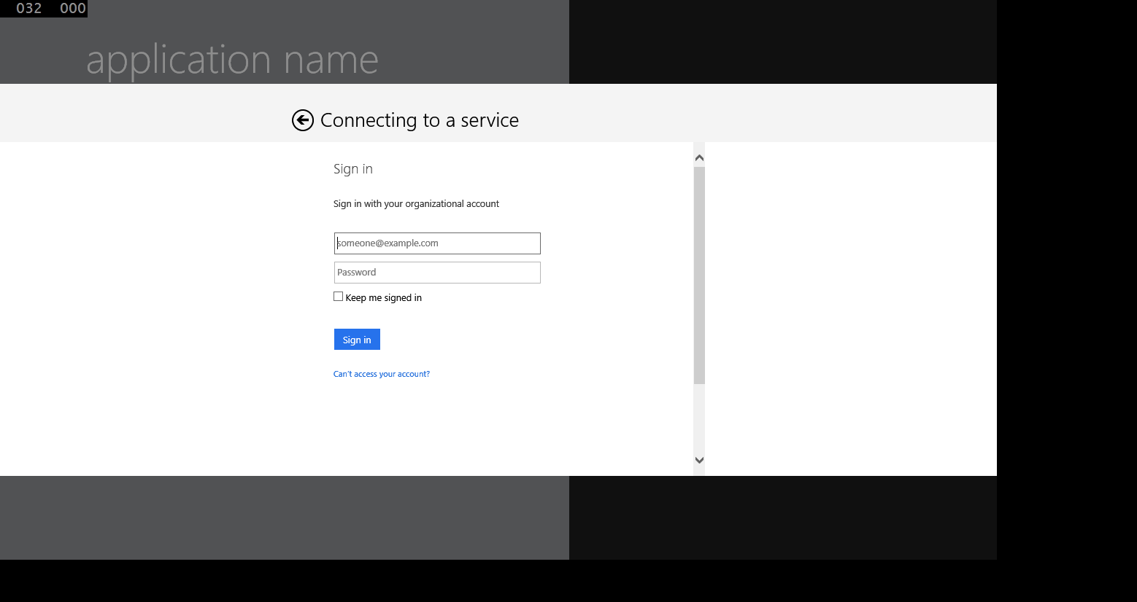
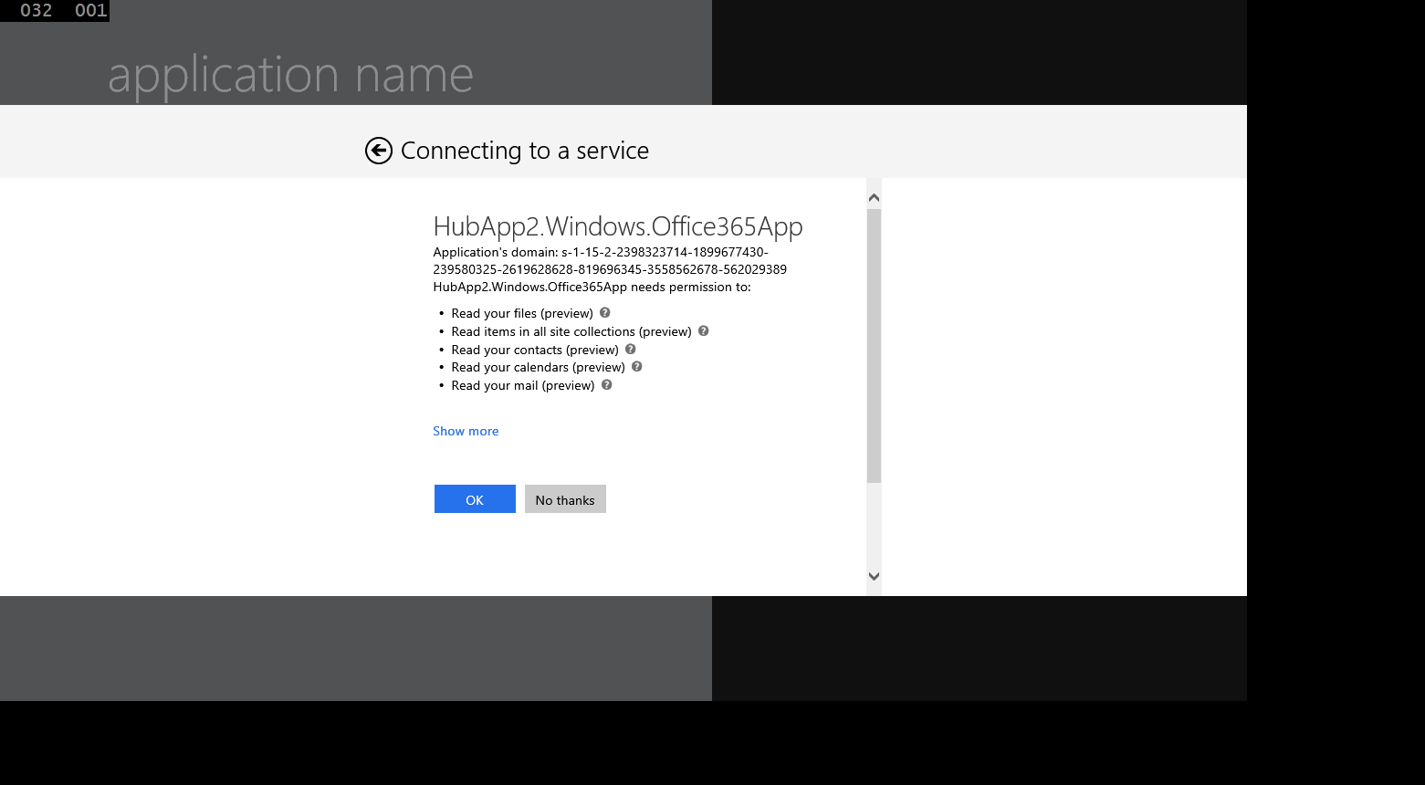
Authentication UI

Slide 23
Office 365 Service Communication
“Client” objects for each service
ExchangeClient
SharePointClient
Constructor takes a “token getter” function
DiscoveryContext wraps an AuthenticationContext
AuthenticationContext has methods for getting tokens

Slide 24
“Client” object constructor example
return new ExchangeClient(ExchangeServiceEndpointUri, async () =>
{
return (await _discoveryContext.AuthenticationContext
.AcquireTokenSilentAsync(
ExchangeServiceResourceId,
_discoveryContext.AppIdentity.ClientId,
new ActiveDirectory.UserIdentifier(
dcr.UserId,
UserIdentifierType.UniqueId)
)
).AccessToken;
});

Slide 25
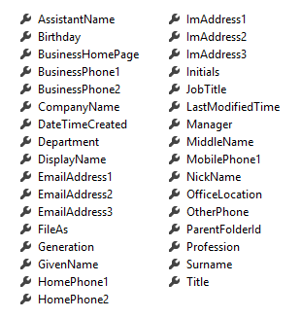
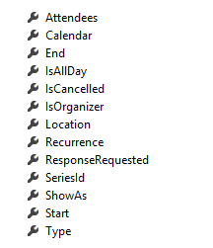
Office 365 Service Communication
Client Object exposes properties
Most are IEnumerable<T> collections
Designed much like Entity Framework
Client == DataContext
IEnumerable<T> entities
Includes common CRUD operations
Contact
Event

Slide 26
Summary
Introduction
Universal App projects
Integrating Office 365 APIs

Slide 27
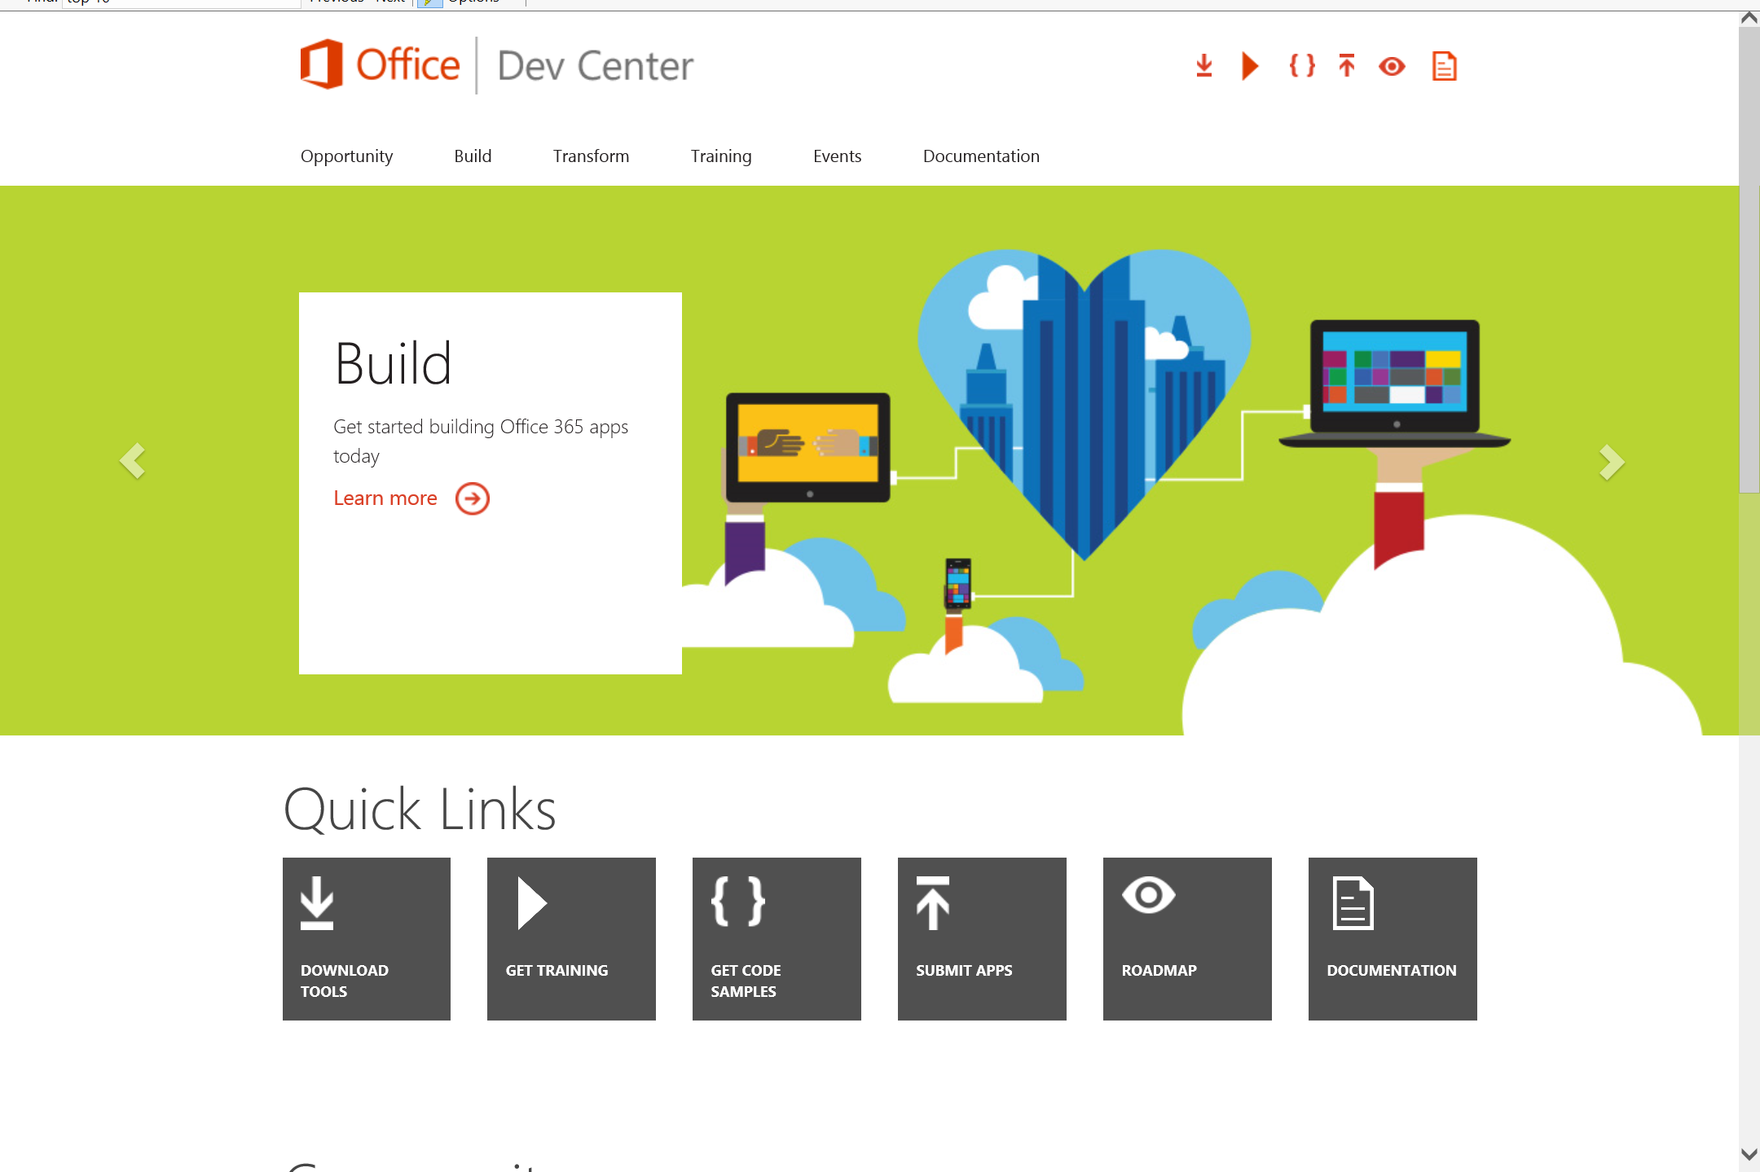
Dev.
Office
.com
One stop shop for Office Developer Platform

Slide 28
Calls to action
Explore our developer center
http://dev.office.com
Jumpstart into our training http://dev.office.com/training
Play with our code samples http://dev.office.com/code-samples
Get answers
http://aka.ms/AskSharePoint
http://aka.ms/AskOffice
Give feedback Drive our roadmap http://aka.ms/OfficeDevFeedback

Slide 29


Transform your code Providing App Model Patterns for common Full Trust Code scenarios
60+ Visual Studio projects Common scenarios
Branding
Site provisioning
Remote event receivers
Large file support
Taxonomy driven navigation
And much more…
Contribute
Open source coming soon!
Developer
Patterns & Practices
aka.ms/OfficeDevPnP

Slide 30
Microsoft Virtual Academy courses
2014
2015
Deep Dive into integrating Office 365 APIs with your mobile device development
Deep dive into the building blocks and services of the SharePoint platform
Deep Dive into integrating Office 365 APIs with your standalone web application development
Introduction to Office 365 Development
Deep Dive into the Office 365 App Model
Deep Dive into Office 365 Development on non-Microsoft Stack
Shipping your Office 365 App to the Office Store
Aug
Sept
Oct
Nov
Dec
Jan
Feb

Slide 31

© 2012 Microsoft Corporation. All rights reserved. Microsoft, Windows, and other product names are or may be registered trademarks and/or trademarks in the U.S. and/or other countries.
The information herein is for informational purposes only and represents the current view of Microsoft Corporation as of the date of this presentation. Because Microsoft must respond to changing market conditions, it should not be interpreted to be a commitment on the part of Microsoft, and Microsoft cannot guarantee the accuracy of any information provided after the date of this presentation. MICROSOFT MAKES NO WARRANTIES, EXPRESS, IMPLIED OR STATUTORY, AS TO THE INFORMATION IN THIS PRESENTATION.

